Slide 1
NG Overview and Market Study
Sorted G’s

Slide 2
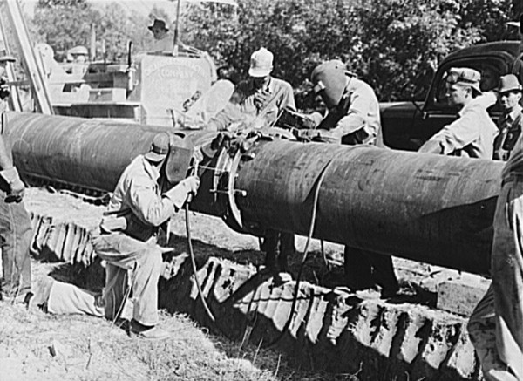
A Brief History
Natural gas has been used for over 2000 years
2400 years ago, Chinese were using it for salt from brine
Britain and USA took to it in the 17th and 18th centuries
Real development after World War 2
Engineering advances - safe, reliable, long distance pipelines for gas transport
Notes:
Other sources: https://www.eia.gov/outlooks/ieo/nat_gas.cfm

Slide 3


The Traditional Process
Gas Fired Evaporators to generate salt from brine
Gas from Shallow Wells
Transported via Bamboo Pipes

Slide 4
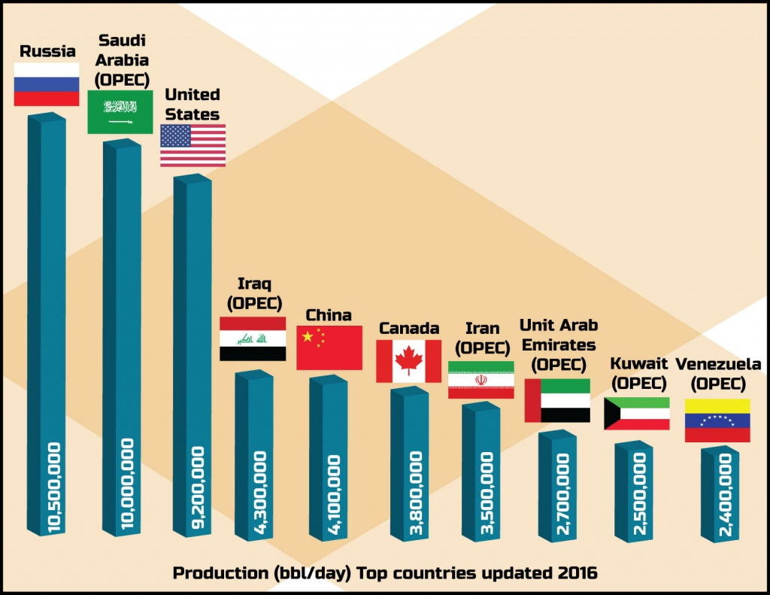
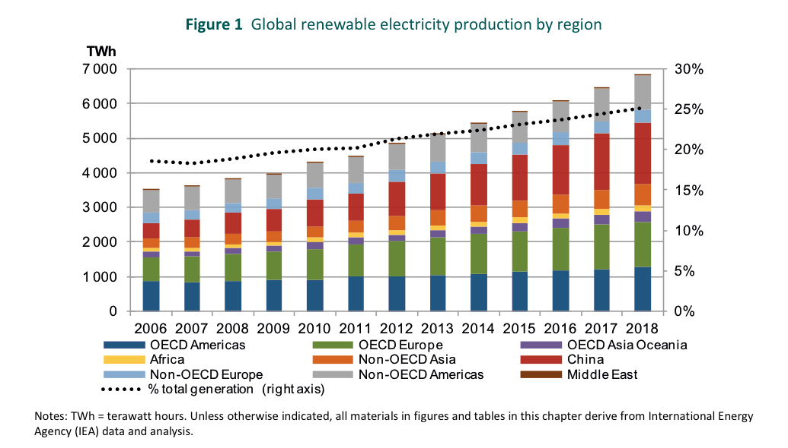
The Global Production Figures

Slide 5
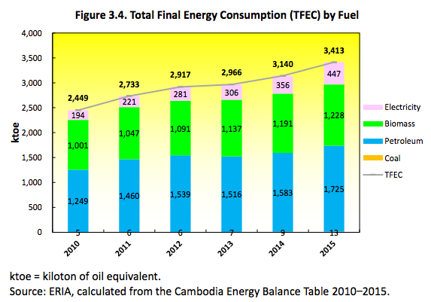
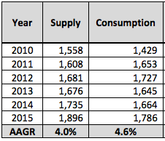
Cambodia Energy Mix: Total Primary Energy Consumption
Oil Statistics
Notes:
Average TPES growing at 6.9%
Average Oil growing at 4.6%
No commercial extraction of oil and gas in cambodian territory
http://www.eria.org/RPR_FY2015_08.pdf
(What is the gas consumption) Let us try and be a little specific here

Slide 6
Cambodia Energy Demand
Low levels of energy access
Low demand per-capita
The potential for growth is huge, especially if domestic, commercial production and infrastructure were to take off.
Until demand reaches the estimated 250 MMSCFD in 2027, there is a huge demand for NG and it’s by products in SE Asia creating a potential for exports (e.g. Vietnam).
Notes:
https://www.iea.org/publications/freepublications/publication/WEO2015_SouthEastAsia.pdf (29)

Slide 7
The Proposition and Market Study
Sold to TP at $5/MMBTU
Third Party
(We are going to be carrying out a detailed study on them)
Propane to nearby LPG bottling plant
Khmer Gas
Sold back to Khmer Gas. Rate??
Butanes to Camboco refinery
Natural Gas Reservoir
Stabilized NGL to Camboco refinery

Slide 8
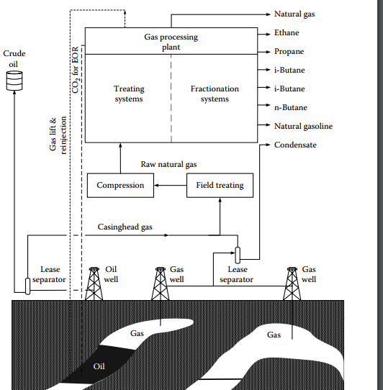

Slide 9
The Proposition and Market Study
Sold to TP at $5/MMBTU
Third Party
(We are going to be carrying out a detailed study on them)
Propane to nearby LPG bottling plant
Khmer Gas
Sold back to Khmer Gas. Rate??
Butanes to Camboco refinery
Natural Gas Reservoir
Butanes to Camboco refinery

Slide 10
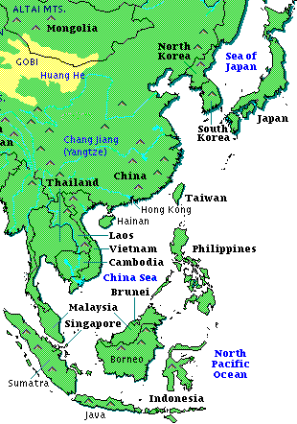

Slide 11
Factors on which NG Prices Depend
Weather Patterns (Only long term impact. Also, climate change!)
Storage Reports (What are the available stocks)
Regulatory Environment (Are the prices regulated)
New Discoveries (like ours! US Shale Gas. Gas in South East Asia)
Futures Markets (Demand Forecasts)
Technological Developments (Cheaper LNG Technologies)

Slide 12
NG Forecasts and Projections
NG forecasts are based on analysis of the current demand and other data available
The projections are based on assumptions which have been made for future growth taking factors such as energy policy, supply constraints and capital investment into consideration
While the forecasts and assumptions seem to be on similar lines, we have nonetheless provided them separately. Our major document for reference is the WEO Energy Outlook 2016.

Slide 13
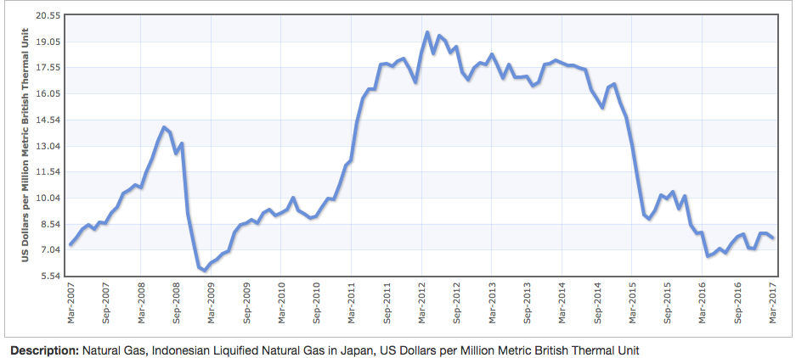
Southeast Asian NG Prices Up to March 2017

Slide 14
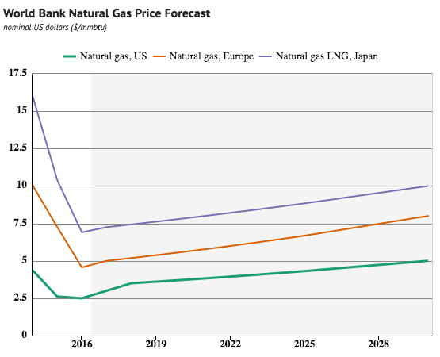
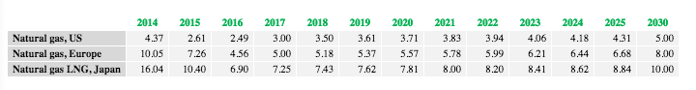
NG Price Forecasts
Prices are expected to continue to rise at a rate of 2.5% per year over the next 10 years and through 2030 as consumption of natural gas continues to increase worldwide (World Bank).
Indonesian LNG price, Japan is our best approximation.
Notes:
https://knoema.com/ncszerf/natural-gas-prices-forecast-long-term-2017-to-2030-data-and-charts
https://knoema.com/gxgnieg/commodity-price-forecast-tracker?commodity=Natural%20gas%20LNG%2C%20Japan

Slide 15
Data Used for the Forecast
Current oil prices expected to grow at a rate of 2% pa over the next 10 years. Expected to reach around $60-65/bbl by 2027
Supply sources to continue to remain the same in South East Asia as the ones today with only LNG terminals in Myanmar, Indonesia and Malaysia that are under construction being considered as a part of the future NG mix.
Technologies for natural gas processing and LNG regasification will continue to remain the same

Slide 16

WEO 2016 - Basic Energy Outlook for Southeast Asia
Energy demand has risen by over 50% between 2000 and 2013
Regional economies expected to triple in size and population expected to increase to about 760 million
Currently, Indonesia and Malaysia are the major gas producing nations
Cambodia is the weakest economy of all ASEAN nations
Energy policy target - Reduce energy consumption by 20% from Business as Usual Level
Low Levels of Energy Access in Cambodia and low per capita energy demand. Huge scope for development of oil and gas production in the region

Slide 17
WEO 2016 - Basic Energy Outlook for Southeast Asia
Major impacts of climate change on the region as most countries are coastal
All signatories of the Paris Climate Convention and are strongly considering renewables
There has been no natural gas policy majorly set up in countries apart from Indonesia and Malaysia as it has not been a major priority till now
No major stockholding capacity set except for operational purposes in Malaysia
LNG rules the roost. Japan is a very ready buyer. Republic of Korea is not far behind
While there is a much higher demand for natural gas than the projected growth in supply, the slow growth is credited to abundant and cheap coal and several supply challenges such as a lack of FSRUs

Slide 18
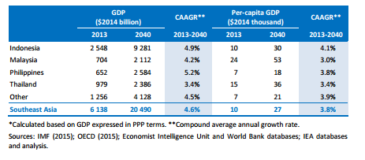
Cambodia is currently the weakest economy. GDP (PPP) is $18 billion and GDP (per capita) is around $1 billion. CAAGR expected to be 4.5% though
Notes:
EDIT THIS

Slide 19
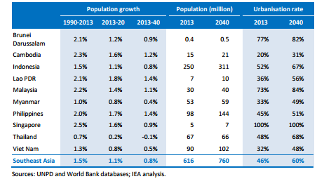
Population Growth Projections for South East Asia

Slide 20
NG Demand and Price Projections
Energy demand expected to rise from around 620 MTOE in 2016 to 1070 MTOE in 2040
Natural gas demand expected to rise by 2/3rds to 265 bcm or 9.358 billion MMBTU
Currently a net exporter but is expected to turn into a net importer by 2040 owing to rising energy demand
Expected 0.64% rise in energy demand for every percentage point of GDP growth.
Expected to reduce as energy and economic growth decouple

Slide 21
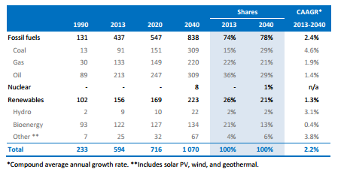
Demand Projections for Different Energy Sources

Slide 22
NG Pricing Estimations
For estimations, we are going to use Brown and Yucel’s simple rule of thumb if required at certain points
This states that the natural gas price is 1/10th of the price of crude oil
Hence, if the cost of crude is $54/bbl, the cost of natural gas will be $5.4/MMBtu
A lot of references have been used for the estimation of prices and current demand forecasts of NG as have been mentioned below

Slide 23
Natural Gas Price Projections
Currently, most contracts for LNG are indexed to oil rates and fixed for contracts extending between 5-10 years
This is expected to end moving forward with Singapore becoming a regional hub
For rough estimations, Brown and Yucel method used
Year and Month | Estimated Price Projection
April 2014 | $18/MMBtu
Early September 2015 | $10/MMBtu
2030 | $12-14/MMBtu

Slide 24
Assumptions
No major supply shocks
No sudden gas booms like the Shale gas boom in USA
Oil prices continue to be cheap
No energy policies that are anti coal are introduced which are different from today’s ones. This will lead to a much higher rise in NG prices
No sudden technological changes which make LNG terminals and regasification processes even cheaper
Population and energy demand rates expected to be similar to the ones that have been suggested by the WEO Outlook 2016 (IEA)

Slide 25
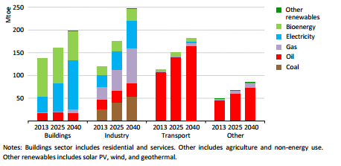
Sector-wise growth for NG in SE Asia

Slide 26
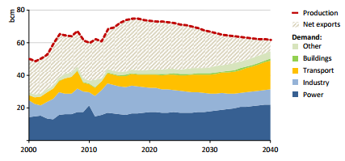
Natural Gas Balance in Malaysia
(Gives a good idea of how net exports are expected to fall)

Slide 27
Overall Summary
Natural gas demand will continue to rise and will increase by about 66% of current levels by 2040 in South East Asia
It faces stiff competition from coal and hence its share in the economy is expected to reduce though
South Korea and Japan are the likely destinations for export. LNG terminals and supporting infrastructure will have to be built
Indigenous use is also major but even for that, there needs to be a supporting infrastructure. No refining capacity, no pipelines. Nothing!
Price forecasts suggest a price of $10/MMBtu by 2030 while price projections give a more likely number of $12-14/MMBtu

Slide 28
References
http://www.indexmundi.com/commodities/?commodity=natural-gas&months=12
https://www.eia.gov/energyexplained/index.cfm?page=natural_gas_factors_affecting_prices
http://www.indexmundi.com/commodities/?commodity=indonesian-liquified-natural-gas&months=120
https://www.iea.org/publications/freepublications/publication/WEO2015_SouthEastAsia.pdf
http://data.worldbank.org/country/cambodia

Slide 29
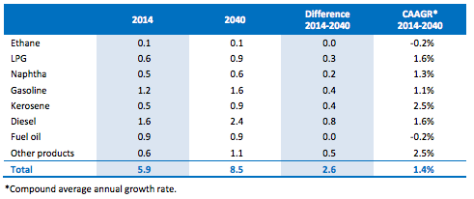
Demand for By-products, NGLs expected to follow NG, generally
Strong gains in NGLs production (0.3 Mb/d p.a.) according to BP Energy Outlook
Entire growth in NGL demand stems from emerging economies (like Cambodia), with the trend decline in OECD demand continuing
If Cambodia were to build up its own capacity to produce and refine, relatively low prices of NG and NGLs could push out competitors in more mature markets that are (planning to) operating with excess capacity.
[mb/d]
Notes:
http://www.transparencymarketresearch.com/natural-gas-liquids-market.html
https://www.bp.com/content/dam/bp/pdf/energy-economics/energy-outlook-2017/bp-energy-outlook-2017.pdf (slide 31)

Slide 30
NGL/ By-product Markets
Butane
N-butane mixed with gasoline to increase its volatility
Mixed with propane to create LPG a widely used domestic fuel with application across all sectors in emerging economies
Converted to isobutane through isomerization
Alternative to CFCs in deodorants, propellants, refrigerants
Propane
Development of propane engines stands to increase propane demand worldwide if it can compete with natural gas/ electric generation sources
Residential/commercial heating and cooking, chemical (ethylene and propylene) production, industrial fuel, engine fuel, and other smaller fuel uses (farm, town gas, and refinery)
Notes:
https://www.hexaresearch.com/research-report/butane-industry
https://www.ihs.com/products/propane-chemical-economics-handbook.html

Slide 31
NGL/ By-product Markets
Ethane
Used with propane to make ethylene and propylene in the manufacture of plastic and other products
Naphtha/ Fuel Oils
Feedstocks for heat generation across industries
Blending agents in other refinery processes
Hydrogen Sulfide
Elemental sulfide, organosulfur compounds used in papermaking, qualitative inorganic analysis of metal ions, separation of heavy water, beauty products

Slide 32
Demand Projections SE Asia
Butane | 4.2% growth per year (vs. global 2.8%) Current demand: 37% of world = 52 MM tons per year 2027 demand: 80 MM tons per year
Propane | 3.8% growth per year (vs. global 2.7%) Current demand: 20 MM tons per year 2027 demand: 30 MM tons per year
Naphtha | 1.6% growth per year (conservatively matching global) Current demand: 16% of Asia demand based on 2015, 2.9MM tons per year 2027 demand: 3.4MM tons per year
Sulfur | Steady, won’t drive further economics
Notes:
Propane: https://www.ihs.com/products/propane-chemical-economics-handbook.html - average of NE asia and world
Demand determined by assuming 35% of worldwide propane is used for propylene generation: http://irpc.listedcompany.com/misc/PRESN/20150515-propylene-market-analyst.pdf
Butane: https://gminsights.wordpress.com/2016/09/08/butane-market/
http://www.opisnet.com/Images/ProductSamples/Asia%20NaphthaLPG-additionalcharts.pdf
Naphtha (heavy): https://www.ihs.com/products/petroleum-liquid-feedstocks-chemical-economics-handbook.html

Slide 33
Price Projections SE Asia
Butane | 2.5% growth per year (assuming prices follow the price of natural gas) Current price: $438/ mt 2027 price: $533/ mt
Propane | 2.5% growth per year through 2025 (assuming prices follow the price of NG) Current price: $388/ mt 2027 price: $472/ mt
NGL’s (Naptha) | 2.5% growth per year (assuming prices follow the price of natural gas) Current price: $438/ mt 2027 price: $591/ mt
Sulfur | 70-80 USD$/ton
Notes:
http://www.opisnet.com/Images/ProductSamples/AsiaNaphtha-sample.pdf
Take advantage of freight prices and be more competitive prices to make more money.

Slide 34
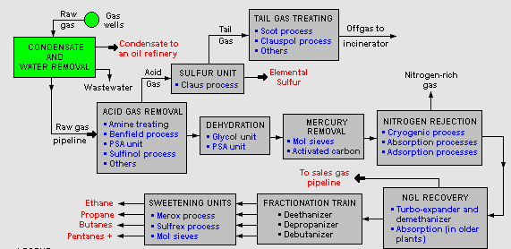
Technical Overview of Natural Gas Processing
Notes:
Remove unnecessary processes
http://www.transparencymarketresearch.com/natural-gas-liquids-market.html
https://www.bp.com/content/dam/bp/pdf/energy-economics/energy-outlook-2017/bp-energy-outlook-2017.pdf (slide 31)

Slide 35
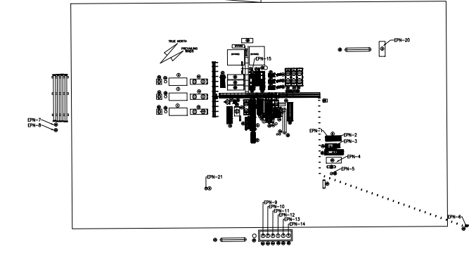
Plot Plan Overview
200 mmscfd
Proposed Targa Longhorn Gas Plant
More formal OSBL with ISBL to present by another group
15 acre
Notes:
https://archive.epa.gov/region6/6pd/air/pd-r/ghg/web/pdf/longhorn-gas-app.pdf

Slide 36
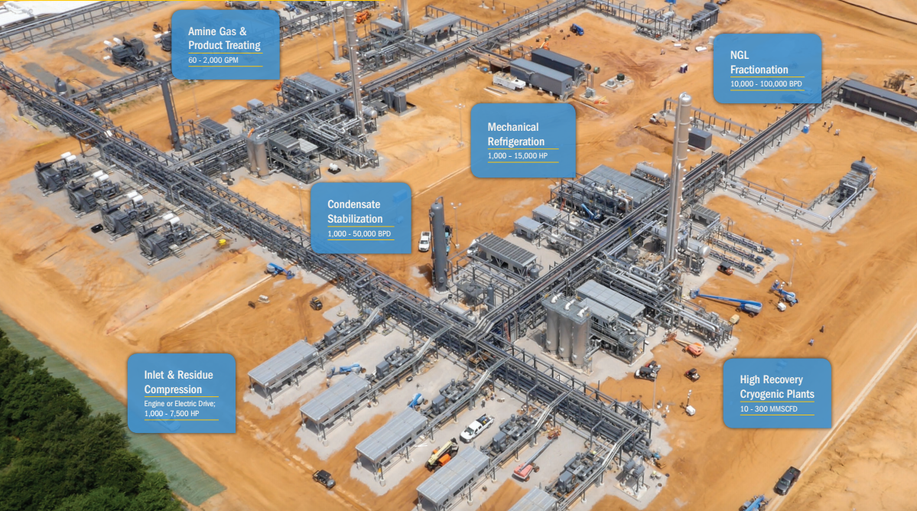
Notes:
http://www.exterran.com/Content/Docs/Products/Process-Treating-Overview.pdf
http://www.exterran.com/Products/gas-processing

